Slide 1
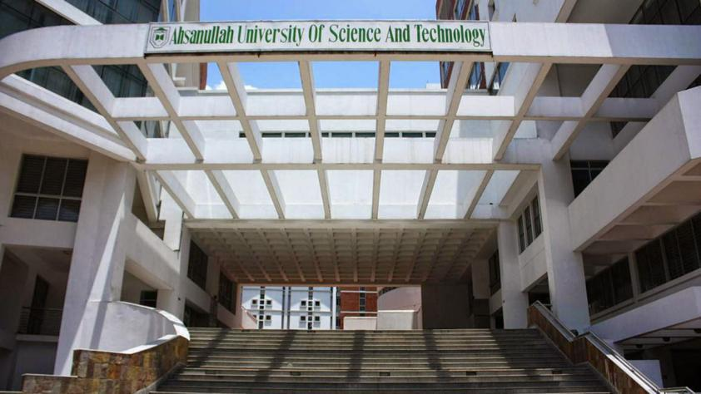

Department of Computer Science & Engineering
Ahsanullah University of Science & Technology

Slide 2
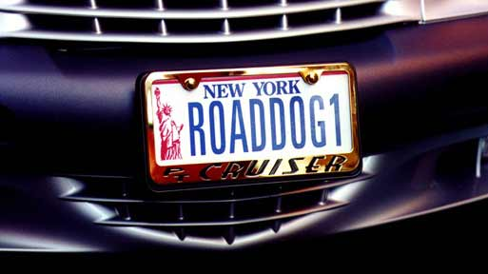
Course No. : CSE 4100
Course Name : Project & Thesis-I Topic : Automated License Plate Recognition (ALPR)

Slide 3
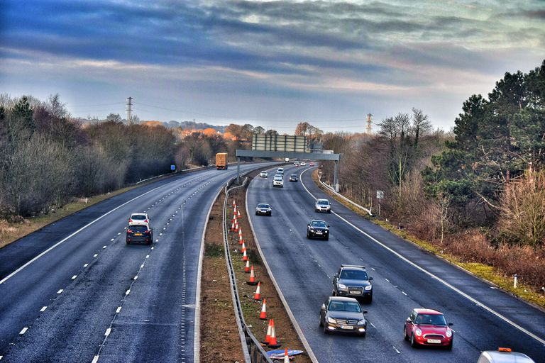
Presented by:
Mirza Tairin Tarique (15-01-04-063)
Md Neaz (15-01-04-065)
Md.Shakhawat Hossain Mridha (15-01-04-067)
Farzana Sharmin Mou (15-01-04-076)
Supervised by:
Mr. Md. Khairul Hasan _{Associate} _{Professor, Dept. of CSE, AUST}

Slide 4
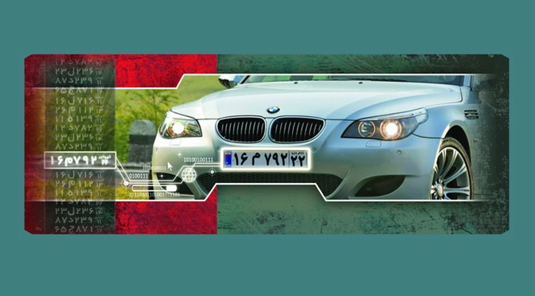
Introduction
ALPR
- Automated License Plate Recognition
Divided into two main steps
- Plate detection
- Plate recognition
Takes images of license plate
Converts these images to text
Cope with international variants

Slide 5
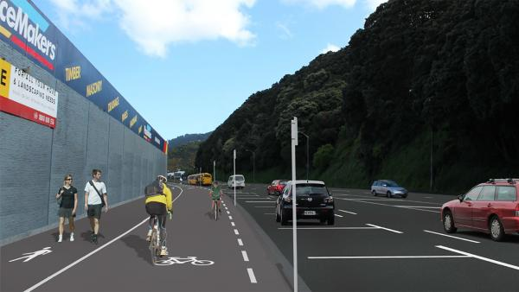
Purpose
Electronic Toll collection
Monitor vehicles
Search stolen car
Traffic control
Suspicious car detection at border crossing
Automated parking garages
Scan crime related cars

Slide 6
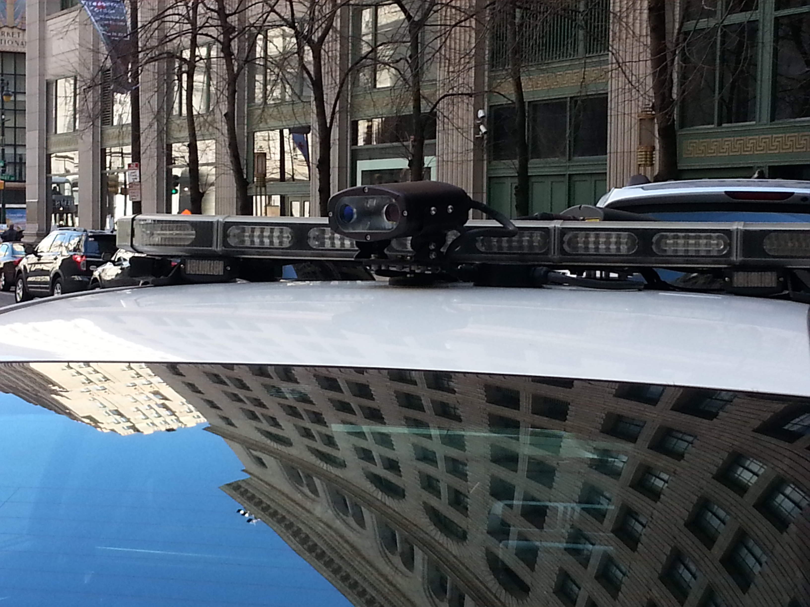
Motivation
Reduce traffic jam by
- Automated toll collection
Application in law enforcement
- Search targeted cars
- Fine the cars parking at wrong place

Slide 7
Background Study
Review on the papers we read:
An Efficient Approach for Automatic Number Plate Recognition System under Image Processing
By Sarbjit Kaur and Sukhvir Kaur
Designed for processing low contrast images
12 steps in the algorithm
Too many usage of manually inserted values reduce down the flexibility of the code for different images
Distinctive features/steps:
Adaptive histogram equalization

Slide 8
Background Study(con.)
Review on the papers we read:
Proposal for Automatic License and Number Plate Recognition System for Vehicle Identification
By Hamed Saghaei
designed for opening a desired mechanized gate in a parking lot
9 steps in the algorithm
Distinctive features/steps:
can process image file as well as video
Plate edge detection omits out the useless area in an extracted number plate

Slide 9
Background Study(con.)
Review on the papers we read:
Automated Car Number Plate Detection System to detect far number plates
by Anisha goyal, Rekha Bhatia
6 steps in the algorithm
Distinctive steps:
Detection of car body
Plate is extracted by rectangular plate mat lab toolbox function
Character recognition using standard classifiers of neural networks

Slide 10
Background Study(con.)
Used tools:
MATLAB R2018b

Slide 11
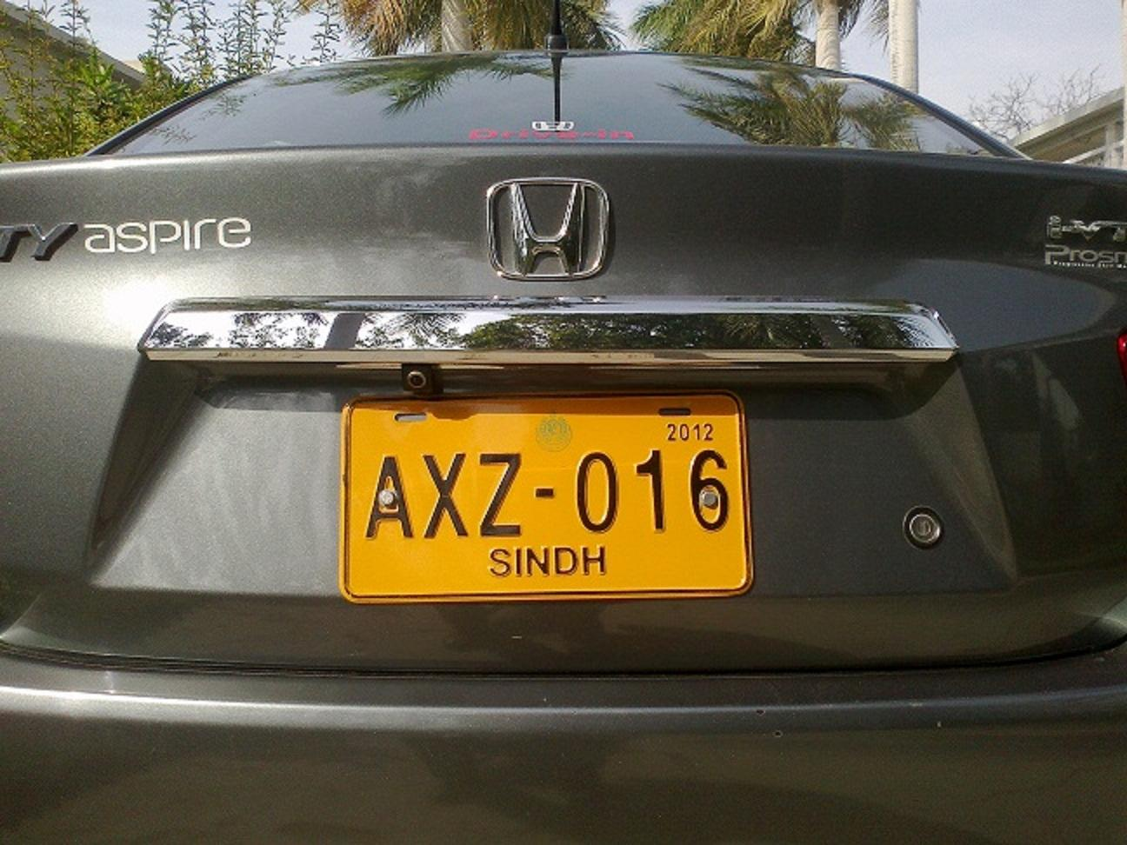
Implementation of the selected paper:
Step-1
1. Input Vehicle image

Slide 12
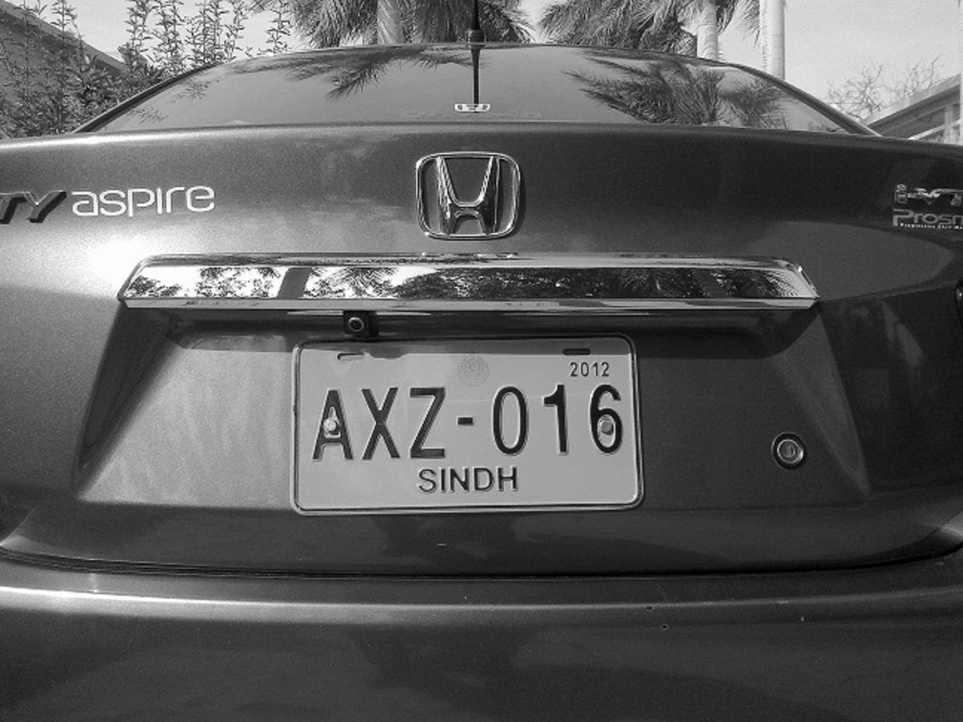
Implementation of the selected paper:
Step-2
1. Input Vehicle image
2. RGB to Grayscale conversion

Slide 13

Implementation of the selected paper:
Step-3
1. Input Vehicle image
2. RGB to Grayscale conversion
3. Noise removal

Slide 14
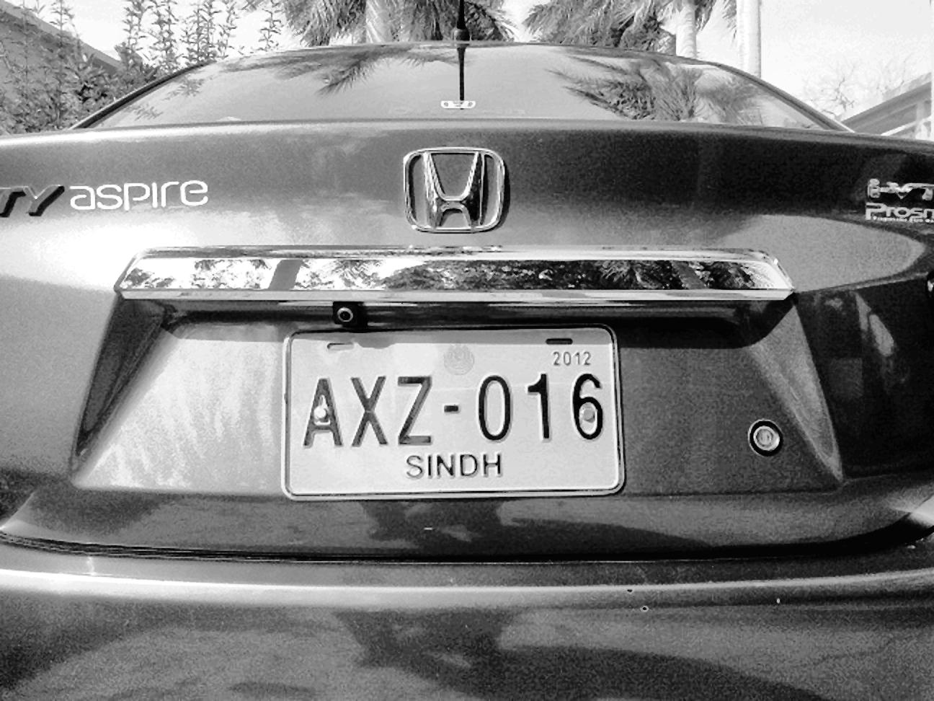
Implementation of the selected paper:
Step-4
1. Input Vehicle image
2. RGB to Grayscale conversion
3. Noise removal
4. Contrast enhancement using AHE

Slide 15

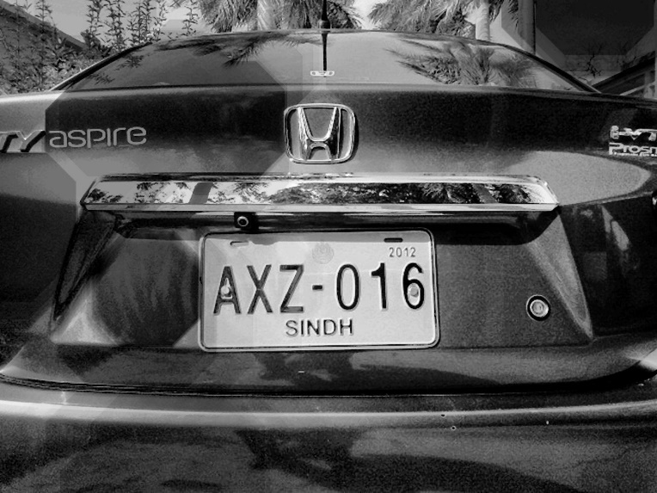
Implementation of the selected paper:
Step-5
1. Input Vehicle image
2. RGB to Grayscale conversion
3. Noise removal
4. Contrast enhancement using AHE
5. Morphological opening and image subtraction operations
Opening effect using disk
Image subtraction operation

Slide 16
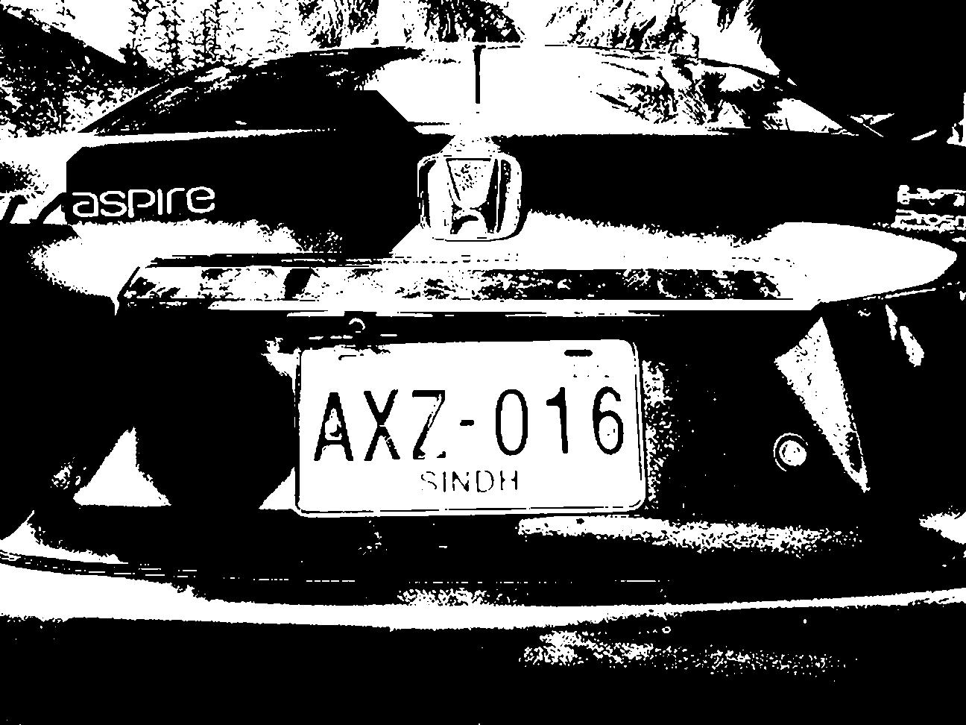
Implementation of the selected paper:
Step-6
1. Input Vehicle image
2. RGB to Grayscale conversion
3. Noise removal
4. Contrast enhancement using AHE
5. Morphological opening and image subtraction operations
6. Image binarization

Slide 17
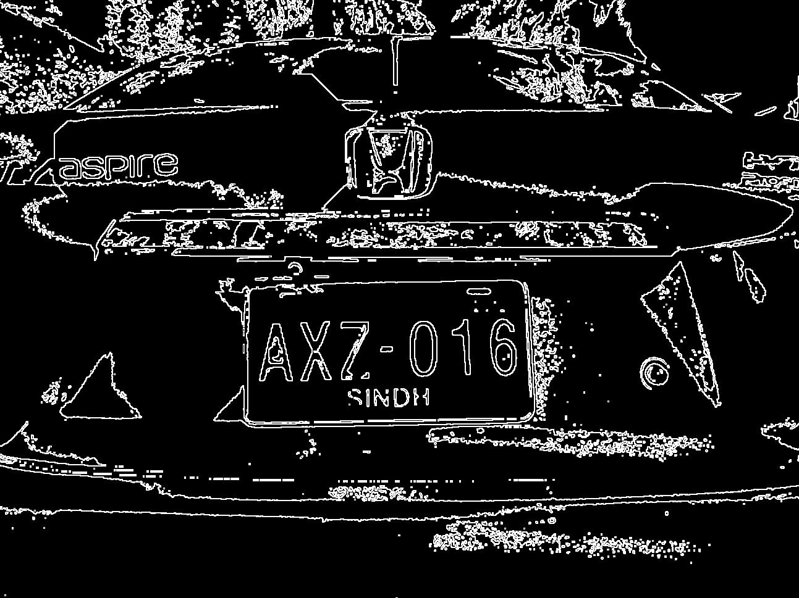
Implementation of the selected paper:
Step-7
1. Input Vehicle image
2. RGB to Grayscale conversion
3. Noise removal
4. Contrast enhancement using AHE
7. Edge detection by Sobel operator
5. Morphological opening and image subtraction operations
6. Image binarization

Slide 18
Implementation of the selected paper:
1. Input Vehicle image
2. RGB to Grayscale conversion
3. Noise removal
4. Contrast enhancement using AHE
8. Candidate plate area detection by Morphological opening and closing operation
7. Edge detection by Sobel operator
5. Morphological opening and image subtraction operations
6. Image binarization

Slide 19
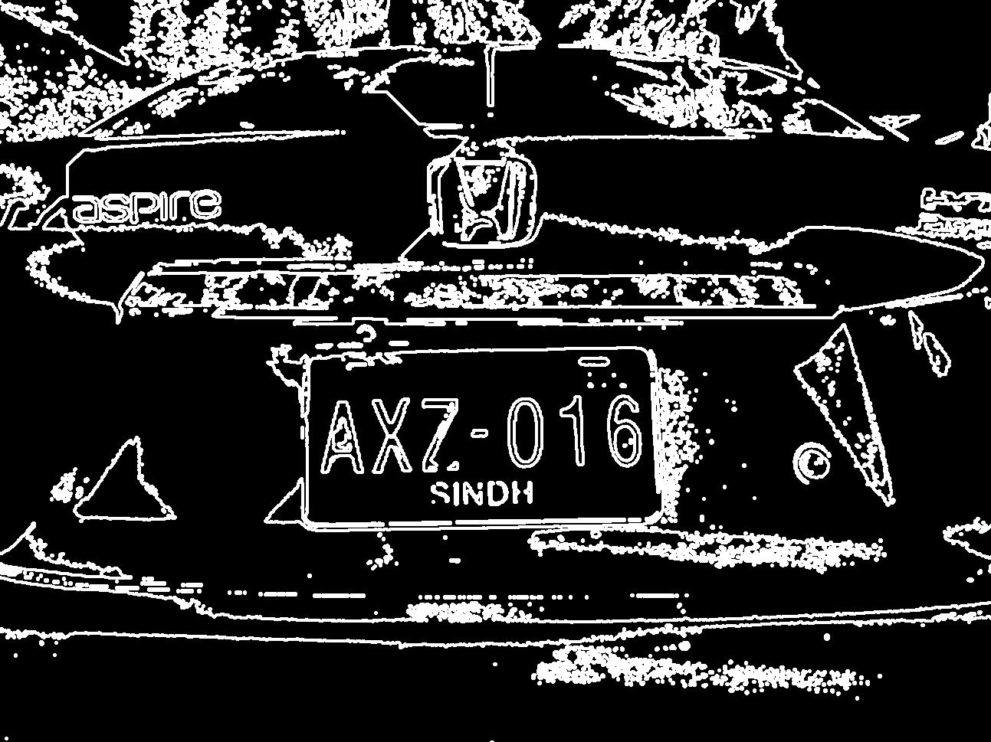
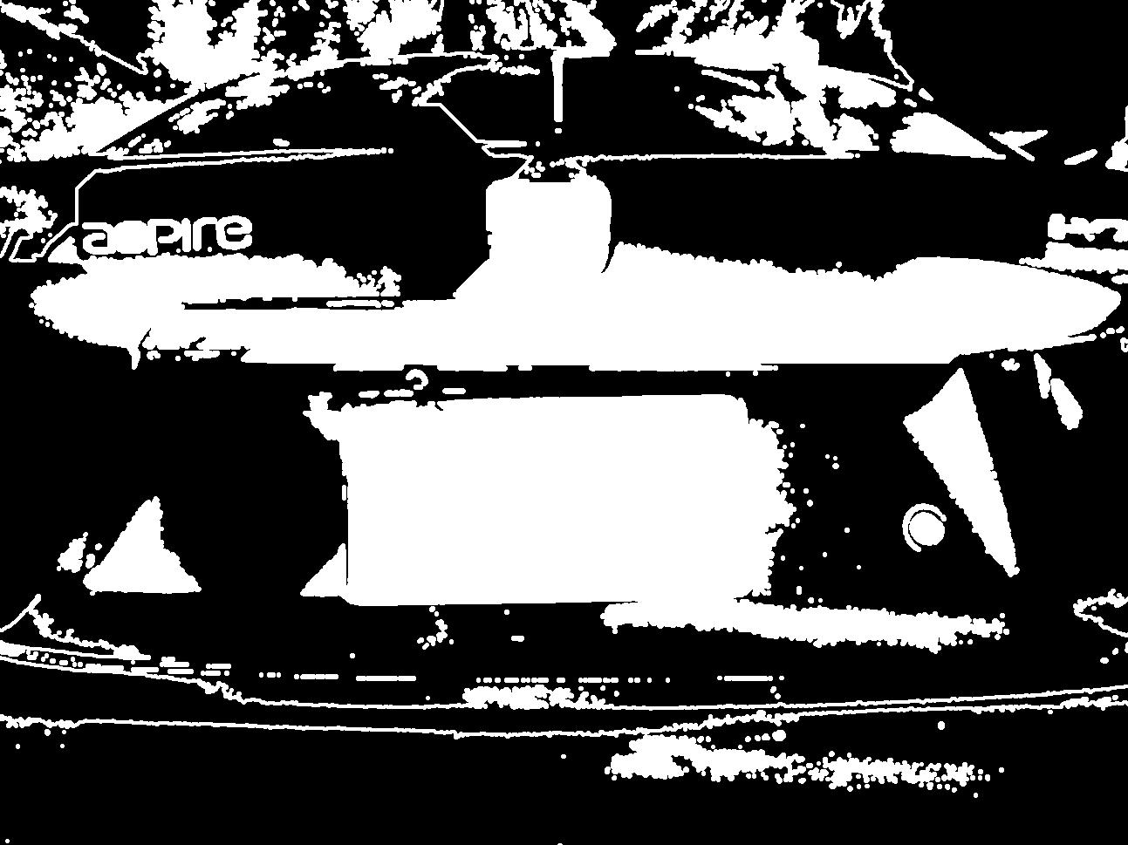
Implementation of the selected paper:
Step-8
After Dilation
After imfill

Slide 20

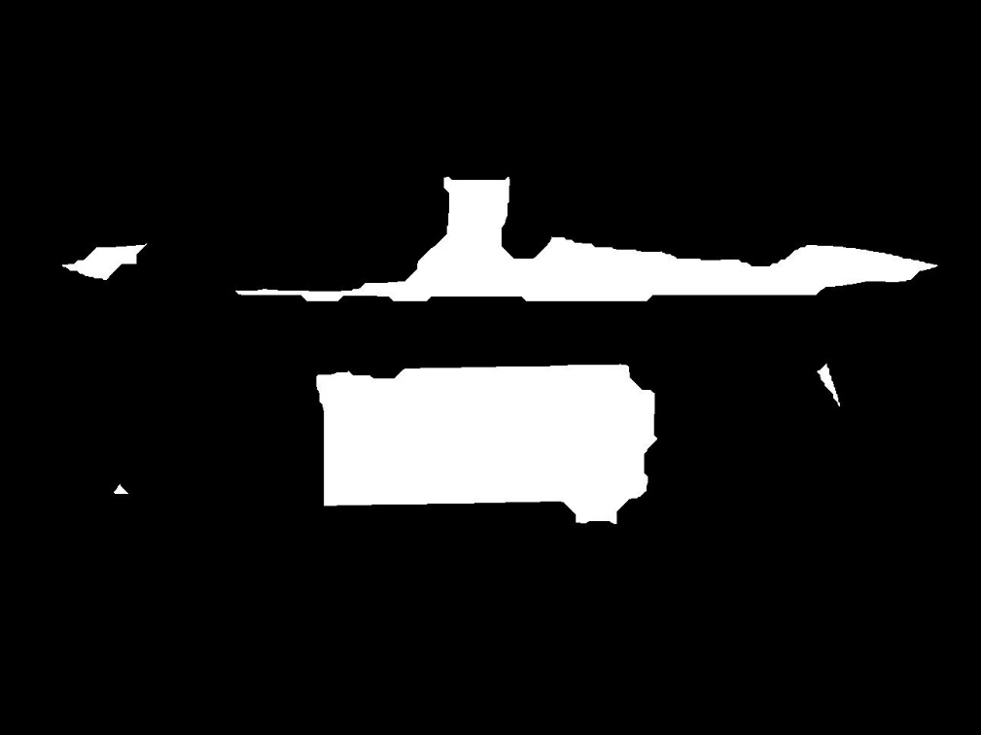
Implementation of the selected paper:
Step-8(Continued)
After Open operation
After erosion operation

Slide 21
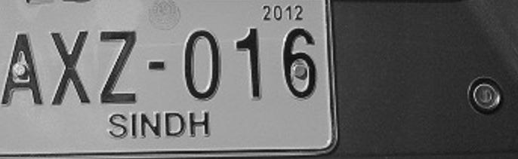
Implementation of the selected paper:
1. Input Vehicle image
2. RGB to Grayscale conversion
3. Noise removal
4. Contrast enhancement using AHE
9. Actual number plate extraction
8. Candidate plate area detection by Morphological opening and closing operation
7. Edge detection by Sobel operator
5. Morphological opening and image subtraction operations
6. Image binarization
Step-9

Slide 22
Implementation of the selected paper:
1. Input Vehicle image
2. RGB to Grayscale conversion
10. Enhancement of extracted plate using Morphological operation
3. Noise removal
4. Contrast enhancement using AHE
9. Actual number plate extraction
8. Candidate plate area detection by Morphological opening and closing operation
7. Edge detection by Sobel operator
5. Morphological opening and image subtraction operations
6. Image binarization

Slide 23


Implementation of the selected paper:
Step-10
After binarization
After dilation

Slide 24
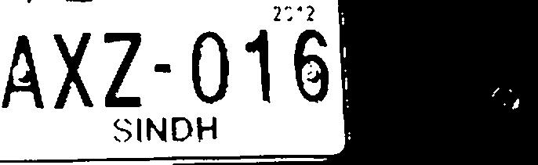


Implementation of the selected paper:
Step-10(continued)
After erosion
After opening closing operation
After complementation

Slide 25
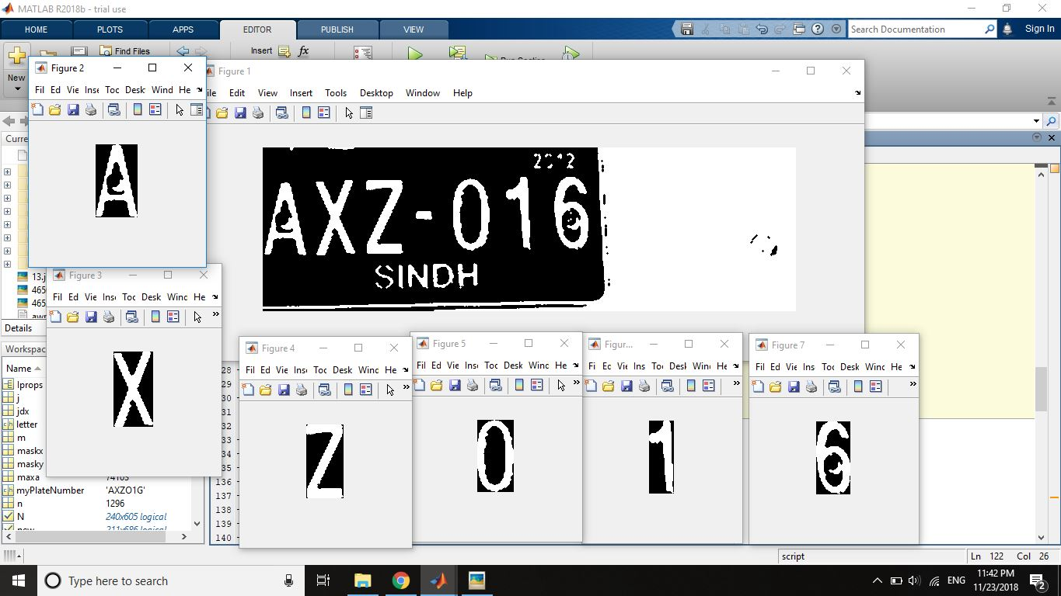
Implementation of the selected paper:
Step-11
1. Input Vehicle image
2. RGB to Grayscale conversion
10. Enhancement of extracted plate using Morphological operation
3. Noise removal
4. Contrast enhancement using AHE
9. Actual number plate extraction
8. Candidate plate area detection by Morphological opening and closing operation
7. Edge detection by Sobel operator
5. Morphological opening and image subtraction operations
6. Image binarization
11. Character segmentation

Slide 26
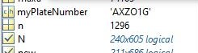
Implementation of the selected paper:
1. Input Vehicle image
2. RGB to Grayscale conversion
10. Enhancement of extracted plate using Morphological operation
3. Noise removal
4. Contrast enhancement using AHE
9. Actual number plate extraction
8. Candidate plate area detection by Morphological opening and closing operation
7. Edge detection by Sobel operator
5. Morphological opening and image subtraction operations
6. Image binarization
11. Character segmentation
12. Character recognition
Step-12

Slide 27
Output of the paper we selected:
Car No. | Steps of the Algorithm
 | (1) Input | (2) Rgb to gray | (3) Denoi-sing | (4) AHE | (5) Morpho-logical operation | (6) Binari-zation | (7) Sobel Edge | (8) Plate detec-tion | (9) Plate extrac-tion | (10) Enhance-ment | (11) segmen-tation | (12) Character Recog-nition
1 | ✔ | ✔ | ✔ | ✔ | ✔ | ✔ | ✔ | ✔ | ✔ | ✔ | ✔ | ✔
2 | ✔ | ✔ | ✔ | ✔ | ✔ | ✔ | ✔ | ✔ | ✔ | ✔ | ✔ | ✔
3 | ✔ | ✔ | ✔ | ✔ | ✔ | ✔ | ✔ | ✔ | ✔ | ✔ | ✔ | ✔
4 | ✔ | ✔ | ✔ | ✔ | ✔ | ✔ | ✔ | ✔ | ✔ | ✔ | ✔ | × (6->G)
5 | ✔ | ✔ | ✔ | ✔ | ✔ | ✔ | ✔ | ✔ | ✔ | ✔ | ✔ | ✔
6 | ✔ | ✔ | ✔ | ✔ | ✔ | ✔ | ✔ | ✔ | ✔ | ✔ | ✔ | ×
7 | ✔ | ✔ | ✔ | ✔ | ✔ | ✔ | ✔ | ✔ | ✔ | ✔ | ✔ | ✔
8 | ✔ | ✔ | ✔ | ✔ | ✔ | ✔ | ✔ | ✔ | ✔ | ✔ | ✔ | × (2-> Z, 0-> U)
9 | ✔ | ✔ | ✔ | ✔ | ✔ | ✔ | ✔ | ✔ | ✔ | ✔ | ✔ | ✔
10 | ✔ | ✔ | ✔ | ✔ | ✔ | ✔ | × | × | × | × | × | ×
11 | ✔ | ✔ | ✔ | ✔ | ✔ | ✔ | ✔ | ✔ | ✔ | ✔ | ✔ | ✔
12 | ✔ | ✔ | ✔ | ✔ | ✔ | ✔ | ✔ | × | × | × | × | ×
13 | ✔ | ✔ | ✔ | ✔ | ✔ | ✔ | ✔ | ✔ | ✔ | ✔ | ✔ | ×
14 | ✔ | ✔ | ✔ | ✔ | ✔ | ✔ | × | × | × | × | × | ×
15 | ✔ | ✔ | ✔ | ✔ | ✔ | ✔ | ✔ | ✔ | ✔ | ✔ | ✔ | ×
16 | ✔ | ✔ | ✔ | ✔ | ✔ | ✔ | ✔ | × | × | × | × | ×
17 | ✔ | ✔ | ✔ | ✔ | ✔ | ✔ | ✔ | ✔ | ✔ | ✔ | ✔ | ×
18 | ✔ | ✔ | ✔ | ✔ | ✔ | ✔ | ✔ | × | × | × | × | ×

Slide 28
Proposed Model
Implementation of the proposed model :
Step-1
1. Input Vehicle image

Slide 29
Proposed Model(con.)
Implementation of the proposed model :
Step-2
1. Input Vehicle image
2. RGB to Grayscale conversion

Slide 30
Proposed Model(con.)
Implementation of the proposed model :
Step-3
1. Input Vehicle image
2. RGB to Grayscale conversion
3. Noise removal

Slide 31
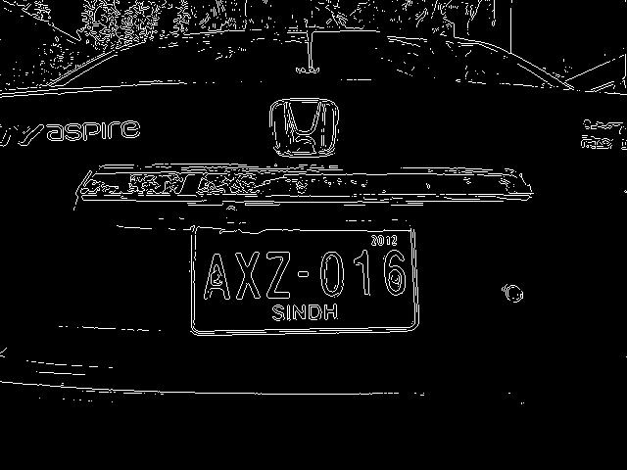
Proposed Model(con.)
Implementation of the proposed model :
Step-4
1. Input Vehicle image
2. RGB to Grayscale conversion
3. Noise removal
4. Edge detection by Sobel operator

Slide 32
Proposed Model(con.)
Implementation of the proposed model :
1. Input Vehicle image
2. RGB to Grayscale conversion
3. Noise removal
4. Edge detection by Sobel operator
5. Candidate plate area detection by Morphological opening and closing operation

Slide 33
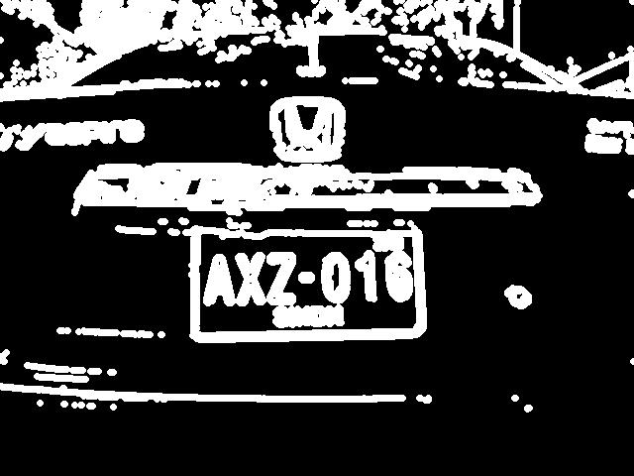
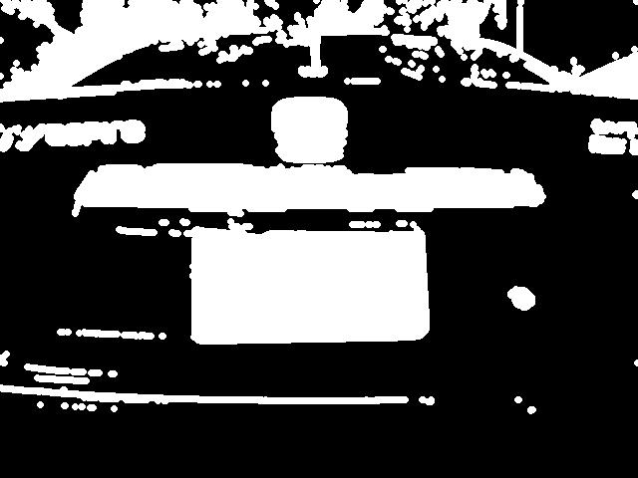
Proposed Model(con.)
Implementation of the proposed model :
Step-5
After dilation
After imfill

Slide 34


Proposed Model(con.)
Implementation of the proposed model :
Step-5(continued)
After open operation
After erosion

Slide 35

Proposed Model(con.)
Implementation of the proposed model :
1. Input Vehicle image
2. RGB to Grayscale conversion
3. Noise removal
4. Edge detection by Sobel operator
5. Candidate plate area detection by Morphological opening and closing operation
6. Actual number plate extraction
Step-6

Slide 36
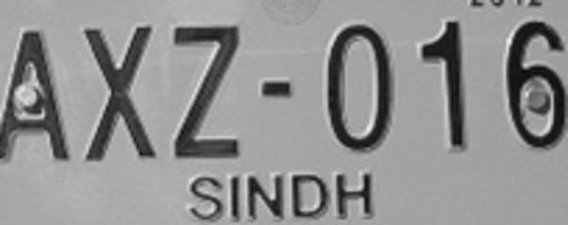
Proposed Model(con.)
Implementation of the proposed model :
1. Input Vehicle image
2. RGB to Grayscale conversion
3. Noise removal
4. Edge detection by Sobel operator
5. Candidate plate area detection by Morphological opening and closing operation
6. Actual number plate extraction
7. Plate resizing
Step-7

Slide 37
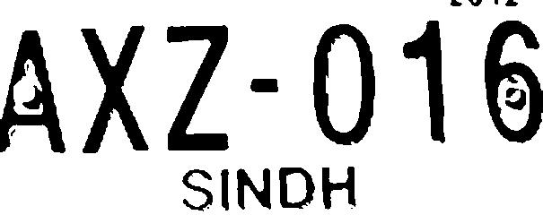

Proposed Model(con.)
Implementation of the proposed model :
Step-8
1. Input Vehicle image
2. RGB to Grayscale conversion
3. Noise removal
4. Edge detection by Sobel operator
5. Candidate plate area detection by Morphological opening and closing operation
6. Actual number plate extraction
7. Plate resizing
8. Enhancement of extracted plate using Morphological operation
After binarization
After complementation

Slide 38

Proposed Model(con.)
Implementation of the proposed model :
1. Input Vehicle image
2. RGB to Grayscale conversion
3. Noise removal
4. Edge detection by Sobel operator
5. Candidate plate area detection by Morphological opening and closing operation
6. Actual number plate extraction
7. Plate resizing
8. Enhancement of extracted plate using Morphological operation
9. Erase out all small components
Step-9

Slide 39
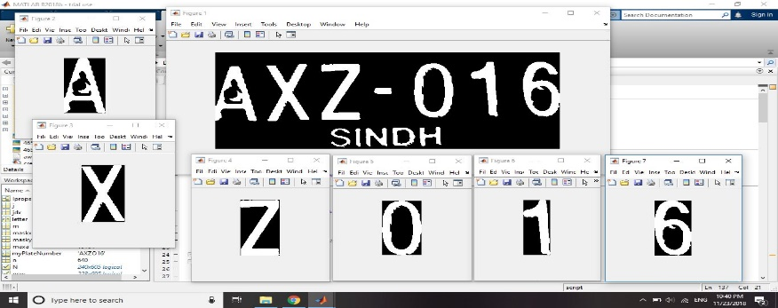
Proposed Model(con.)
Implementation of the proposed model :
1. Input Vehicle image
2. RGB to Grayscale conversion
3. Noise removal
4. Edge detection by Sobel operator
5. Candidate plate area detection by Morphological opening and closing operation
6. Actual number plate extraction
7. Plate resizing
8. Enhancement of extracted plate using Morphological operation
9. Erase out all small components
10. Character segmentation
Step-10

Slide 40
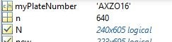
Proposed Model(con.)
Implementation of the proposed model :
1. Input Vehicle image
2. RGB to Grayscale conversion
3. Noise removal
4. Edge detection by Sobel operator
5. Candidate plate area detection by Morphological opening and closing operation
6. Actual number plate extraction
7. Plate resizing
8. Enhancement of extracted plate using Morphological operation
9. Erase out all small components
10. Character segmentation
11. Character recognition
Step-11

Slide 41
Proposed Model(con.)
Output of the proposed model :
 | Step of the algorithm
Car no. | (1) Input | (2) Rgb to gray | (3) Noise reduction | (4) Sobel | (5) Candidate plate area detection | (6) Actual number plate area extraction | (7) Plate Resizing | (8) Region enhancement | (9) Erase out small compo-nent | (10) Char segmen-tation | (11) Char reading
1 | ✔ | ✔ | ✔ | ✔ | ✔ | ✔ | ✔ | ✔ | ✔ | ✔ | ✔
2 | ✔ | ✔ | ✔ | ✔ | ✔ | ✔ | ✔ | ✔ | ✔ | ✔ | ✔
3 | ✔ | ✔ | ✔ | ✔ | ✔ | ✔ | ✔ | ✔ | ✔ | ✔ | ✔
4 | ✔ | ✔ | ✔ | ✔ | ✔ | ✔ | ✔ | ✔ | ✔ | ✔ | ✔
5 | ✔ | ✔ | ✔ | ✔ | ✔ | ✔ | ✔ | ✔ | ✔ | ✔ | ✔
6 | ✔ | ✔ | ✔ | ✔ | ✔ | ✔ | ✔ | ✔ | ✔ | ✔ | ✔
7 | ✔ | ✔ | ✔ | ✔ | ✔ | ✔ | ✔ | ✔ | ✔ | ✔ | ×(R->P)
8 | ✔ | ✔ | ✔ | ✔ | ✔ | ✔ | ✔ | ✔ | ✔ | ✔ | ×(2->Z)
9 | ✔ | ✔ | ✔ | ✔ | ✔ | ✔ | ✔ | ✔ | ✔ | ✔ | ✔
10 | ✔ | ✔ | ✔ | × | × | × | × | × | × | × | ×
11 | ✔ | ✔ | ✔ | ✔ | ✔ | ✔ | ✔ | ✔ | ✔ | ✔ | ✔
12 | ✔ | ✔ | ✔ | ✔ | ✔ | ✔ | ✔ | ✔ | ✔ | ✔ | ×(D->O)
13 | ✔ | ✔ | ✔ | ✔ | ✔ | ✔ | ✔ | ✔ | ✔ | ✔ | ×
14 | ✔ | ✔ | ✔ | ✔ | ✔ | ✔ | ✔ | ✔ | ✔ | ✔ | ×
15 | ✔ | ✔ | ✔ | ✔ | ✔ | ✔ | ✔ | ✔ | ✔ | ✔ | ×
16 | ✔ | ✔ | ✔ | ✔ | ✔ | ✔ | ✔ | ✔ | ✔ | ✔ | ×(3->5)
17 | ✔ | ✔ | ✔ | ✔ | ✔ | ✔ | ✔ | ✔ | ✔ | ✔ | ×
18 | ✔ | ✔ | ✔ | ✔ | ✔ | ✔ | ✔ | ✔ | ✔ | × | ×

Slide 42
Modification
Combined flow chart:
1. Input Vehicle image
2. RGB to Grayscale conversion
11. Enhancement of extracted plate using Morphological operation
3. Noise removal
4. Contrast enhancement using AHE
9. Actual number plate extraction
8. Candidate plate area detection by Morphological opening and closing operation
7. Edge detection by Sobel operator
5. Morphological opening and image subtraction operations
6. Image binarization
13. Character segmentation
14. Character recognition
10. Plate resizing
12. Erase out all small components
Meaning of the colours:
Followed the paper
Omitted from paper
Modified step
New added step

Slide 43


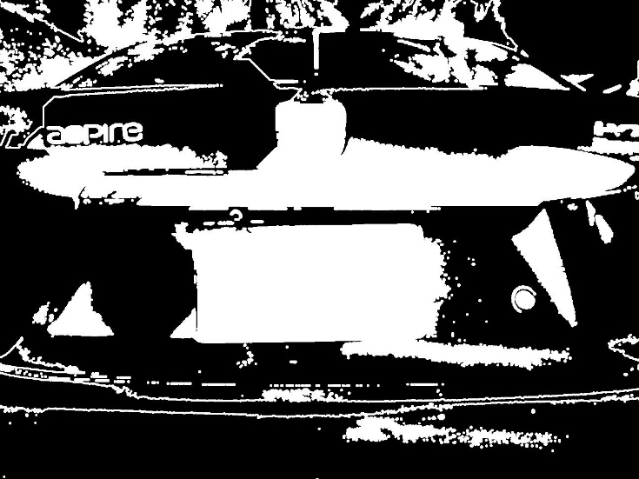
Modification Some steps of selected paper:
Contrast enhanced
image
After binarization
and sobel
After dilation and
filling holes

Slide 44
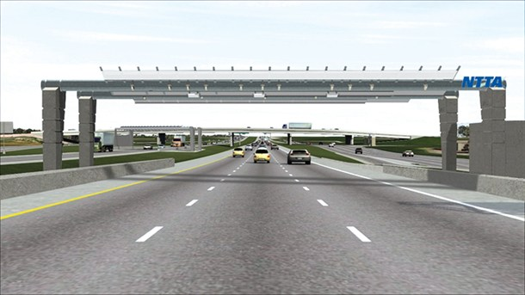

Modification
Step 4,5,6 omitted in proposed model and got this output:
Grayscale image
After Sobel
After dilation and
filling holes

Slide 45
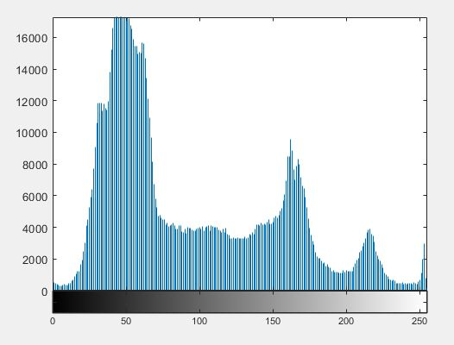
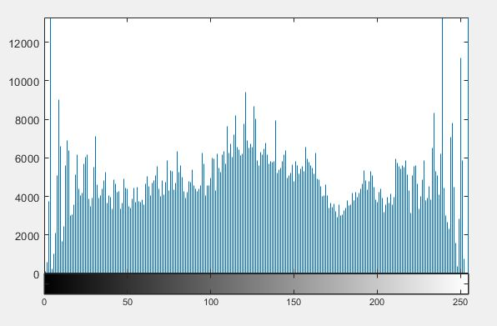
Modification
Reason behind modification at step 4:
Histogram of grayscale
image
Histogram of contrast enhanced
image

Slide 46
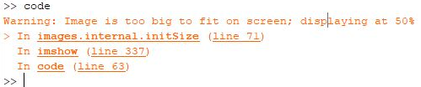
Modification
In the proposed approach, image is resized to 240p to avoid following error:

Slide 47
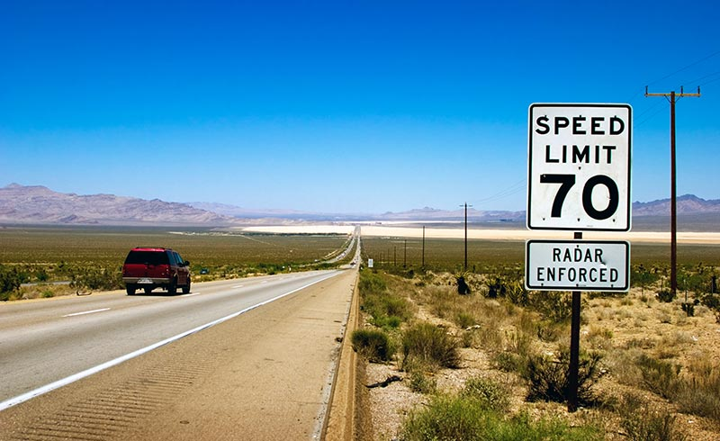
Implementation of the paper we selected:
Modification
Implementation of the paper we selected:
Enhanced region
Output
Enhanced region
After cca
Output

Slide 48
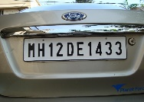
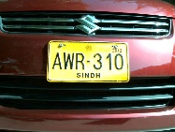
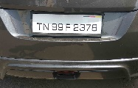
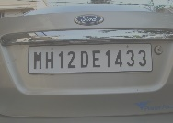
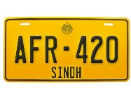
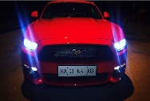
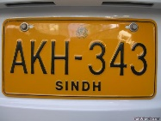
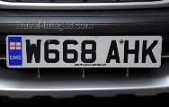
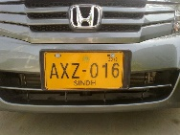

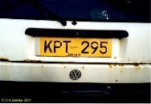
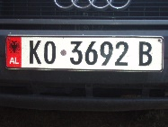
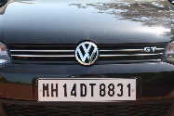
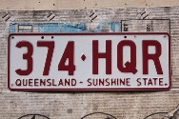
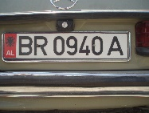
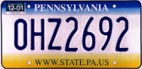
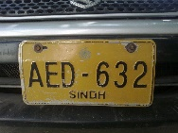
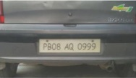
Comparison
Compared result for 18 car images
Input Image | Our Approach | Paper’s Approach
 | ✔ | ✔
 | ✔ | ✔
 | ✔ | ✔
 | ✔ | × (6->G)
 | ✔ | ✔
 | ✔ | ×
Input Image | Our Approach | Paper’s Approach
 | × (R -> P) | ✔
 | × (2 -> Z) | ×(2 ->Z, O->U)
 | ✔ | ✔
 | × | ×
 | ✔ | ✔
 | × (D -> O) | ×
Input Image | Our Approach | Paper’s Approach
 | × (×) | ×
 | × (×) | ×
 | × (×) | ×
 | × (3 -> 5) | ×
 | × (×) | × (×)
 | × | ×

Slide 49
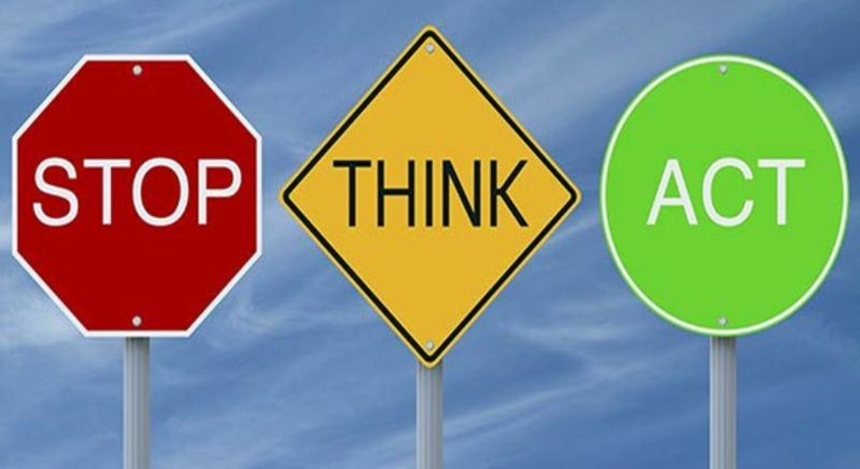
Future Plan
Using bilateral filter to remove noise
Use template matching for character recognition
Use more steps to acquire more accuracy
Real time implementation

Slide 50
Conclusion
Accuracy Table:
88.88% correct plate detected by our model
72.22% correct plate detected by paper’s model
44.44% correct number detected by our model
38.88% correct number detected by paper’s model
Stages of ALPR | Model | Total number of images | Success | Failure | Success Rate(%)
Character Segmentation | Proposed | 18 | 16 | 2 | 88.88
 | Selected | 18 | 13 | 5 | 72.22
Character Recognition | Proposed | 18 | 8 | 10 | 44.44
 | Selected | 18 | 7 | 11 | 38.88

Slide 51


Slide 52


